Slide 1
Introduction To Full Stack Web Development
By: PARUL MADAN(CSE)
GRAPHIC ERA DEEMED TO BE UNIVERSITY

Slide 2
Definition of Full Stack Web Development
Full stack development refers to the development of both front end and back end portions of an application. This web development process involves all three layer Presentation layer(front end part that deals with the user interface), Business Logic Layer(back end part that deals with data validation) and the database Layer. It takes care of all the steps from the conception of an idea to the actual finished.

Slide 3
Languages used in Full Stack Web Development
HTML, HTML5, CSS3, JavaScript, jQuery for front-end development
Node.js, Meteor.js, Angular, PHP, Ruby on Rails for back-end development
MySQL, MongoDB, PostgreSQL, CouchDB, Apache Cassandra for Database understanding
GIT, Subversion, Task Runners, Debuggers for version control and debugging
Other essential technologies like Memcached, Apache Solr, Apache Lucene and Redis

Slide 4
Mean Stack Web Development
MEAN Stack is one of the most popular Technology Stack. It is used to develop a Full Stack Web Application. Although it is a Stack of different technologies, all of these are based on JavaScript language.
MEAN Stands for:
M – MongoDB
E – Express
A – Angular
N – Node.js

Slide 5
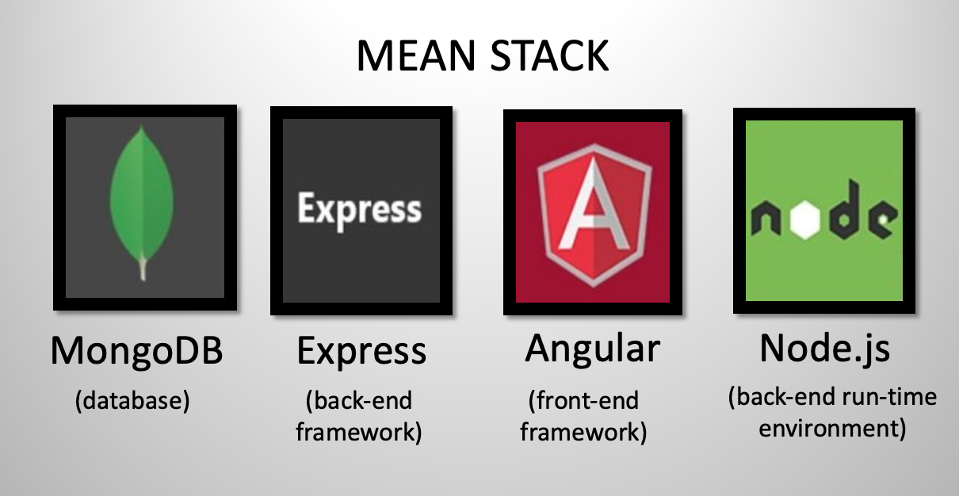
This stack leads to faster development as well as the deployment of the Web Application. Angular is Frontend Development Framework whereas Node.js, Express, and MongoDB are used for Backend development as shown in the below figure:

Slide 6
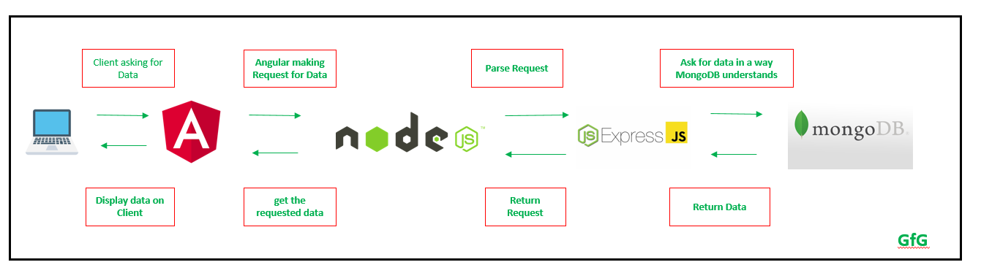
Flow of Data in MEAN Stack Application

Slide 7
What is MongoDb?
It is a NoSQL database
It has no fixed schema unlike MySQL and MsSql
Data is stored in the form of JSON file format unlike MySQL where data is stored in tabular ,manner.
It is free and open source .

Slide 8
Advantages of MongoDb
Unstructured Schema
When data is not related to each other
Good for Big data projects
Companies using MongoDb are:Google,SAP,ebay,Facebook,EA sports.

Slide 9
What is Express(for Backend)?
Express is a web application framework for Node.js. Express handles all the interactions between the frontend and the database, ensuring a smooth transfer of data to the end user. It’s designed to be used with Node.js and so continues the consistent use of JavaScript throughout the stack.
Simple and light weight
Blends well with mean stack.
Easy to configure and customize
Great for creating API.
#It helps in creating prototypes very fast.
#companies using Express are: UBER,Myntra,Yandex,Quizup,Accenture

Slide 10
What is Angularjs
AngularJS—Google’s JavaScript frontend framework—isn’t the only frontend framework in use, but it’s exceedingly popular. AngularJS didn’t become the most popular JavaScript frontend framework by mistake. Its ability to simultaneously develop for desktop and mobile use, its well-tuned performance and its easy-to-use templates make it the ideal front end to build cloud-native applications.
MVC framework for client end application
Helps in creating highly interactive applications
It is free and open source

Slide 11
Advantages of Angularjs
Helps in creating cross platform applications for mobile, desktop and web .
Great support for creating progressive web applications
Backed by Google
Helps you to create single page applications .
Companies uses Angularjs are : Microsoft, JPMORGAN CHASE & CO.

Slide 12
What is Node.js?
Node.js is an open source JavaScript framework that uses asynchronous events to process multiple connections simultaneously. It is an ideal framework for a cloud-based application, as it can effortlessly scale requests on demand.
Node.js is the backbone of the MEAN stack. Express is purpose-built to work on top of Node.js, and AngularJS connects seamlessly to Node.js for fast data serving. Node.js comes complete with an integrated web server, making it easy to deploy your MongoDB database and application to the cloud.
The greatest strength of Node.js is its scalability. Cloud applications are best when they can respond quickly to usage spikes. By expanding your resources as they’re needed, you’re able to serve more users while the framework’s single-thread architecture allows the application to effectively provide a smooth user experience across numerous connections. Node.js can support as many as a million simultaneous connections.

Slide 13
Advantages of Node.js (for backend )
Uses Asynchronous programming
No need to learn new languages to create applications on server.
Helps to create real time applications.
Companies using Nodejs are: LinkedIn, Yahoo, PayPal ,Netflix.

Slide 14
Difference between full stack and mean stack.
Full-stack refers to a group of programming languages and tools a developer learns to handle both the front-end and back-end development of a website. MEAN stack, on the other hand, is a popular full-stack framework, which consists of MongoDB, Express.js, AngularJS, and Nodejs.
Full-stack isn’t necessarily restricted to a particular set of languages, while frameworks like MEAN stack is
Full-stack mainly refers to the developer, whereas MEAN stack is an acronym for a full-stack framework.
MEAN stack developers have a better grip on JavaScript related projects, full-stack developers have more knowledge. As a result, companies benefit from hiring both of them. MEAN stack is a branch of full-stack.

